Slide 1

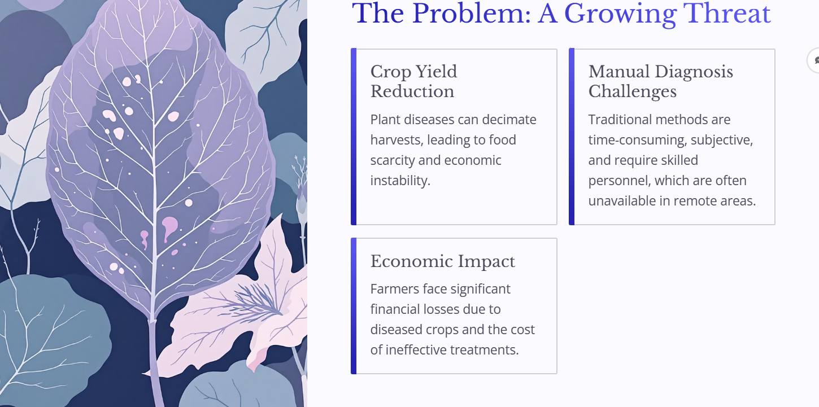
Plant Disease Detection System Using Machine Learning

Slide 2

Introduction: Safeguarding Our Future
Agriculture forms the bedrock of our global economy and food security. However, plant diseases pose a significant threat, leading to substantial crop losses and economic hardship for farmers. Manual disease diagnosis is often slow, inaccurate, and requires expert knowledge, making timely intervention challenging.
This presentation outlines an automated plant disease detection system leveraging machine learning, offering a precise and efficient solution to this critical agricultural challenge.

Slide 3

The Problem: A Growing Threat
Crop Yield Reduction
Manual Diagnosis Challenges
Plant diseases can decimate harvests, leading to food scarcity and economic instability.
Traditional methods are time-consuming, subjective, and require skilled personnel, which are often unavailable in remote areas.
Economic Impact
Farmers face significant financial losses due to diseased crops and the cost of ineffective treatments.

Slide 4

Project Objectives
Automated Detection
1
Develop an automated system using Convolutional Neural Networks (CNNs).
Accurate Predictions
2
Provide highly accurate and rapid disease identification from images.
Farmer Support
3
Empower farmers with timely insights to prevent widespread crop damage.
Efficient Resource Use
4
Promote sustainable agriculture by reducing pesticide overuse.

Slide 5
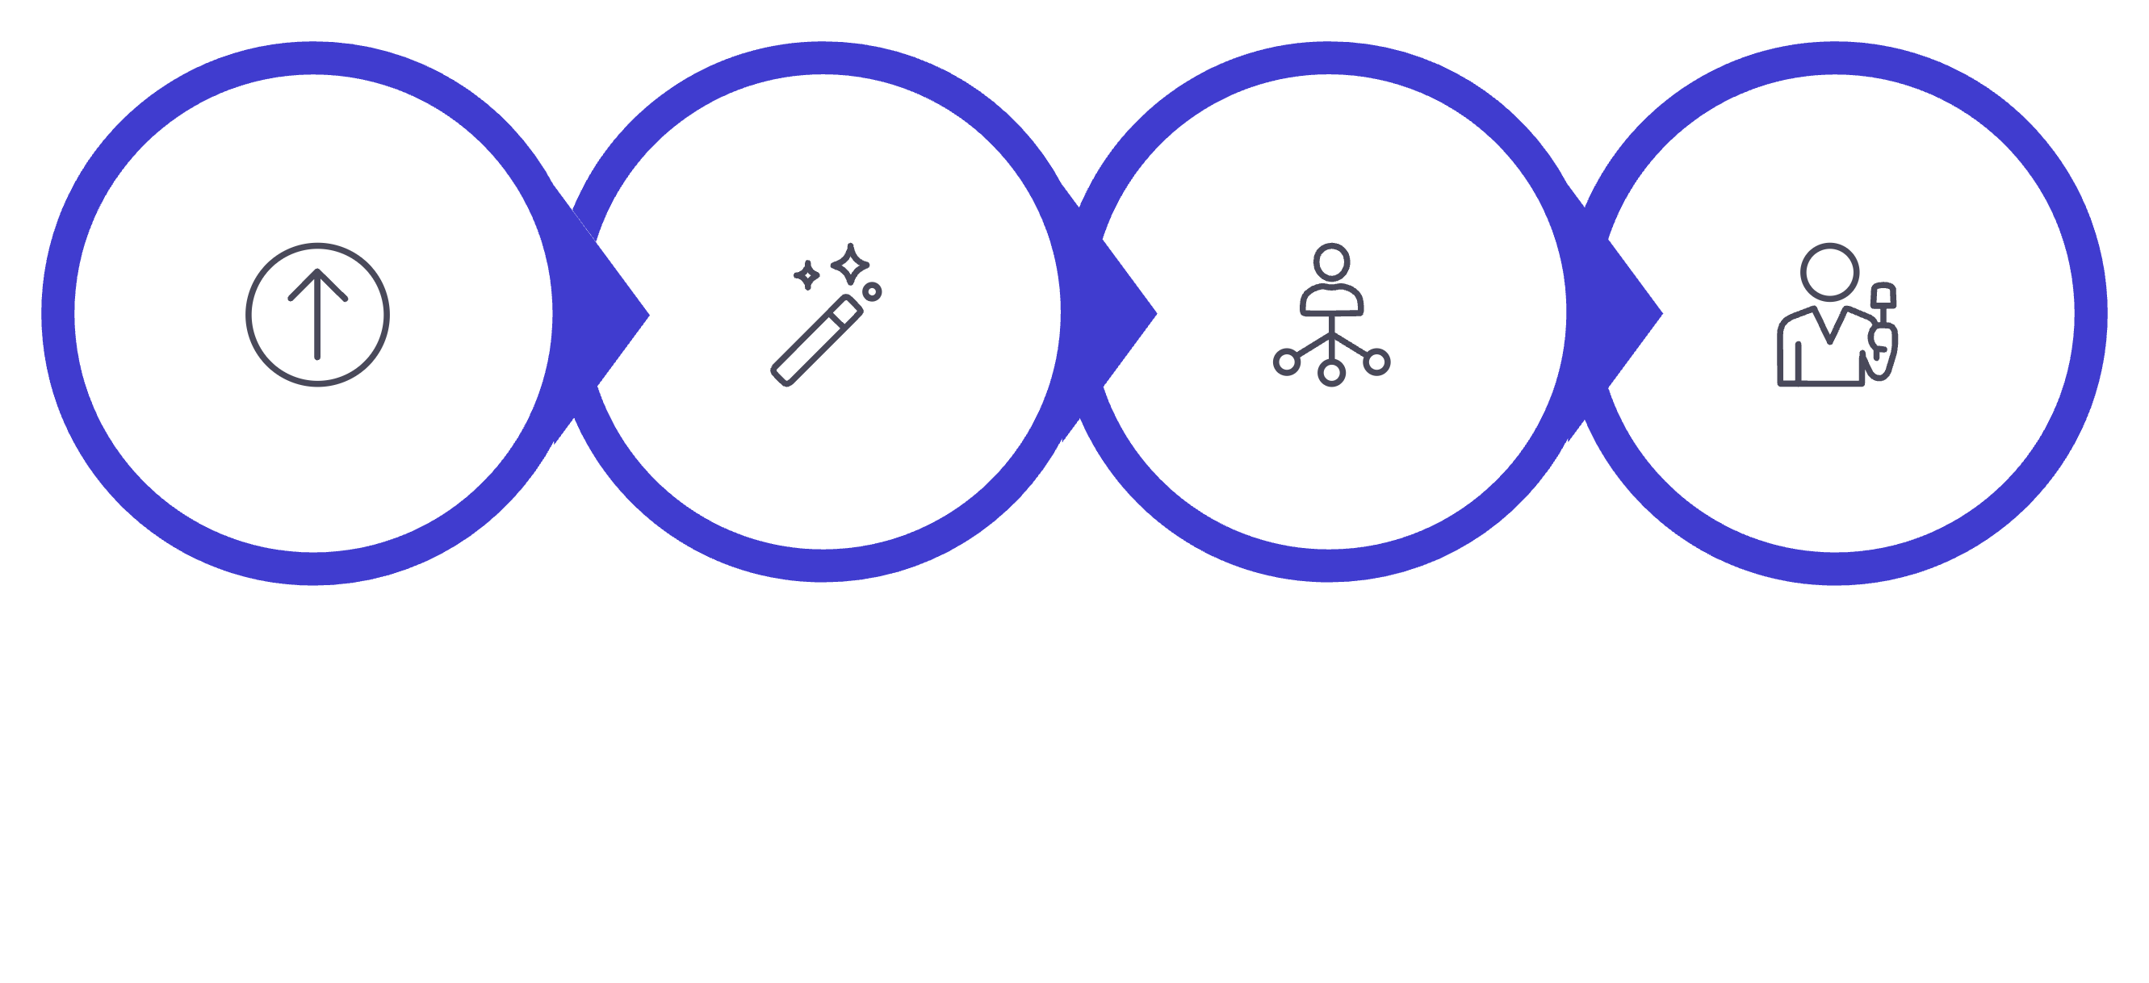




Proposed System Overview
CNN Classification
Image Upload
Preprocessing
Output Generation
The system begins with an image upload, followed by a crucial preprocessing stage to prepare the data. The processed images are then fed into a CNN for classification, which ultimately generates a precise disease diagnosis.

Slide 6

Dataset Description & Technologies
Dataset
Technologies Used
Our model is trained on a comprehensive dataset, including images from the PlantVillage dataset.
Python: Core programming language
TensorFlow/Keras: Machine learning framework
Approximately 87,000 RGB images
OpenCV: Image processing library
14 crop species
NumPy/Matplotlib: Data manipulation and visualization
38 distinct disease classes, 33 test images
80% training, 20% testing split
Streamlit: Web application framework

Slide 7
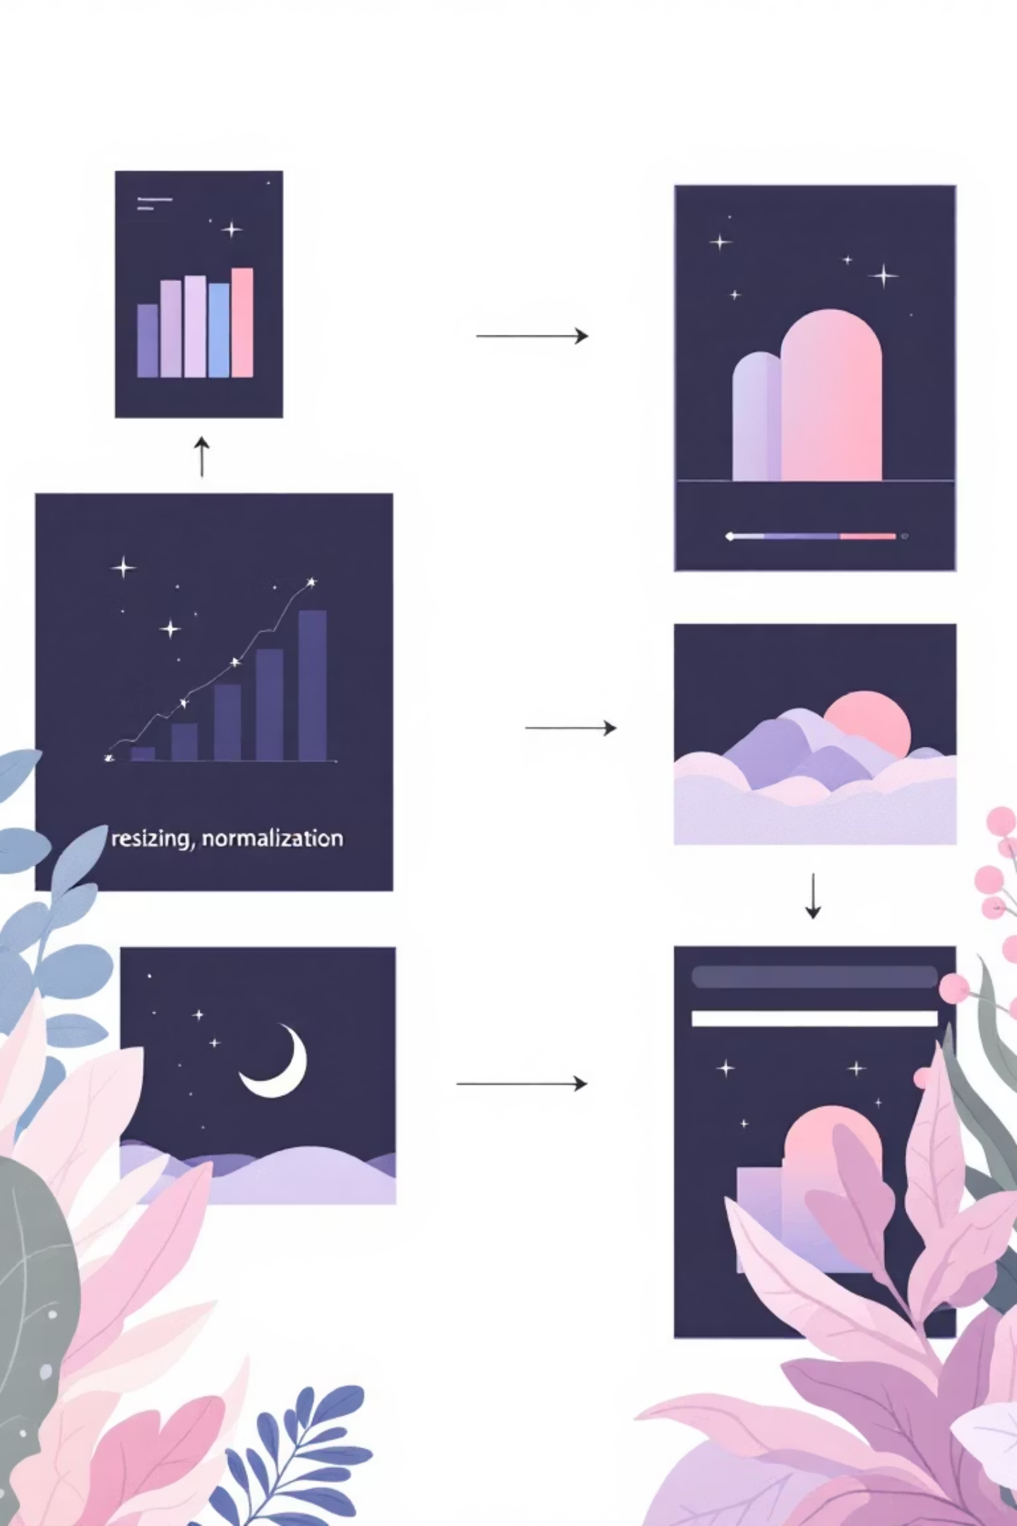



Image Preprocessing Steps
Resizing
Normalization
Standardising image dimensions to a uniform size (e.g., 256x256 pixels).
Scaling pixel values to a fixed range (0-1) to improve model performance.
Data Augmentation
Generating additional training data through rotations, flips, and zooms to enhance model robustness.

Slide 8





CNN Architecture
Input
Conv → Pool
Image data enters the network
Deeper features, reduced dims
Flatten→Dense→Softmax
Conv → Pool
Feature extraction and reduction
Class scores for classification
Our CNN comprises convolutional layers for feature extraction, pooling layers for dimensionality reduction, and dense layers leading to a softmax output for classification. This architecture is optimised for image recognition tasks.

Slide 9

Training Process & Results
Training Parameters
Key Results
Epochs: 10 Full iterations over the entire dataset
Accuracy: Achieved 95.83% validation accuracy and 98.21% training accuracy
Steps per Epoch: 2197
Batch Size: 32 images processed per iteration
Confusion Matrix: Demonstrates high precision and recall
Loss Function: Categorical Cross-Entropy
Optimizer: Adam Optimizer
Sample Predictions: Visually accurate disease identification during Testing phase.

Slide 10




Impact & Future Enhancements
Reduced Crop Loss
Mobile App Integration
Early and accurate detection minimises the spread of diseases.
Develop a user-friendly mobile application for on-field diagnosis.
IoT & Real-time Detection
Larger Datasets
Integrate with IoT devices for continuous, real-time monitoring.
Expand training data to cover more crop types and disease variations.

